Slide 1
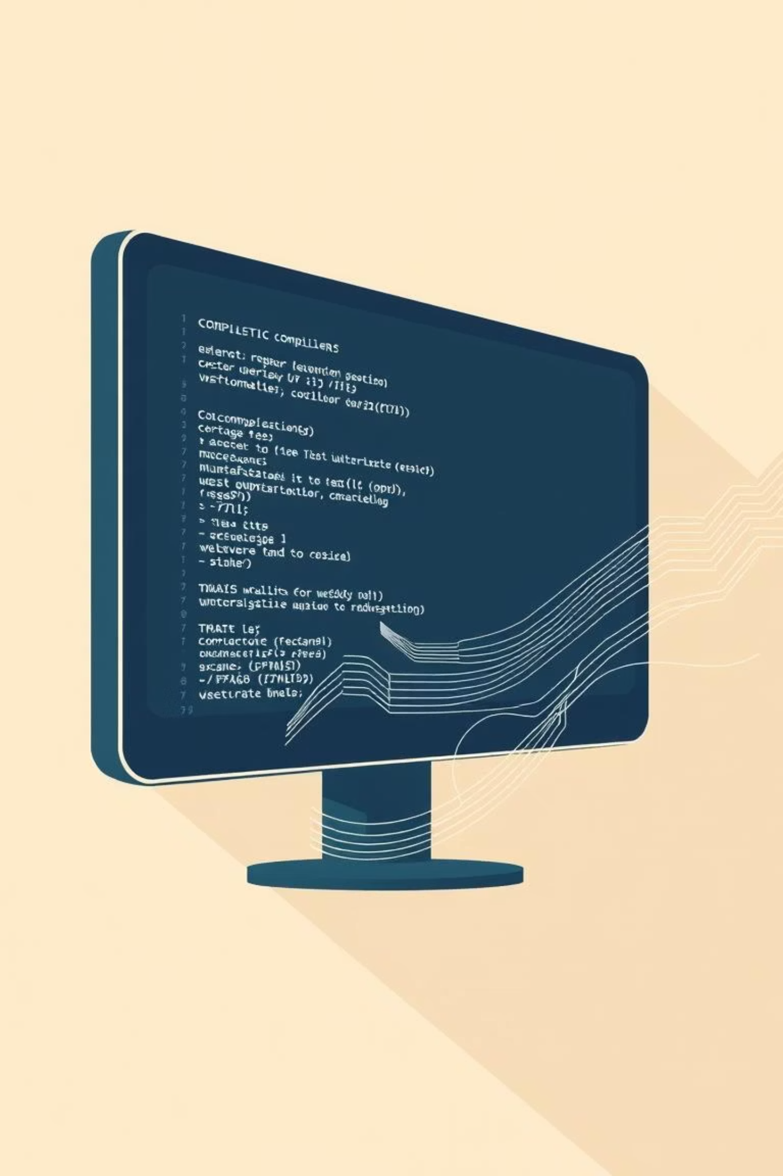
Lexical Analyzer
Compiler Construction Project
Presented by: Muhammad Awais
Subject Supervisor: Madam Faryal Shamsi

Slide 2

Introduction to Lexical Analysis
A Lexical Analyzer (Lexer/Scanner) is the first phase of a compiler. It reads source code, breaks it into tokens, and sends them to the parser.
This project features a GUI-based Lexical Analyzer with:
Source code editor
Token table (Line, Token, Token Type)
Symbol table
Clear & Analyze controls
Developer profile button

Slide 3
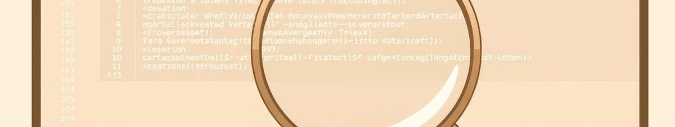



What is Lexical Analysis?
Breaking Code
Cleaning Input
Classifying Tokens
Breaks source code into meaningful units (tokens).
Removes spaces, comments, and irrelevant characters.
Categorizes tokens into Keywords, Identifiers, Operators, Separators, Numbers/Literals.
It converts human-written code into machine-understandable components.

Slide 4





Why is Lexical Analysis Important?
Clean Input
Ensures clean input by removing invalid characters and patterns early.
Compiler Efficiency
Improves compiler efficiency by structuring tokens for syntax analysis.
Early Error Detection
Catches errors like invalid variable names or unexpected characters in the first phase.
Language Foundation
Forms the internal foundation for all programming languages (C, Java, Python, etc.).

Slide 5





Project Objectives
Interactive GUI
Provide a simple & interactive GUI for students.
Workflow Demo
Demonstrate compiler front-end workflow.
Dynamic Tokenization
Tokenize user-written code dynamically.
Table Maintenance
Maintain both token and symbol tables.
Practical Understanding
Facilitate practical understanding of compiler theory.

Slide 6






Application Features
Tkinter GUI
Code Input
User interface built with Tkinter.
Source code input panel.
Token Table
Token Categories
Token table using Treeview.
Supports Keywords, Identifiers, Operators, Numbers, Separators.
Symbol Table
Controls
Symbol Table Generator.
"Clear Source", "Clear Token", "Analyze" buttons.

Slide 7


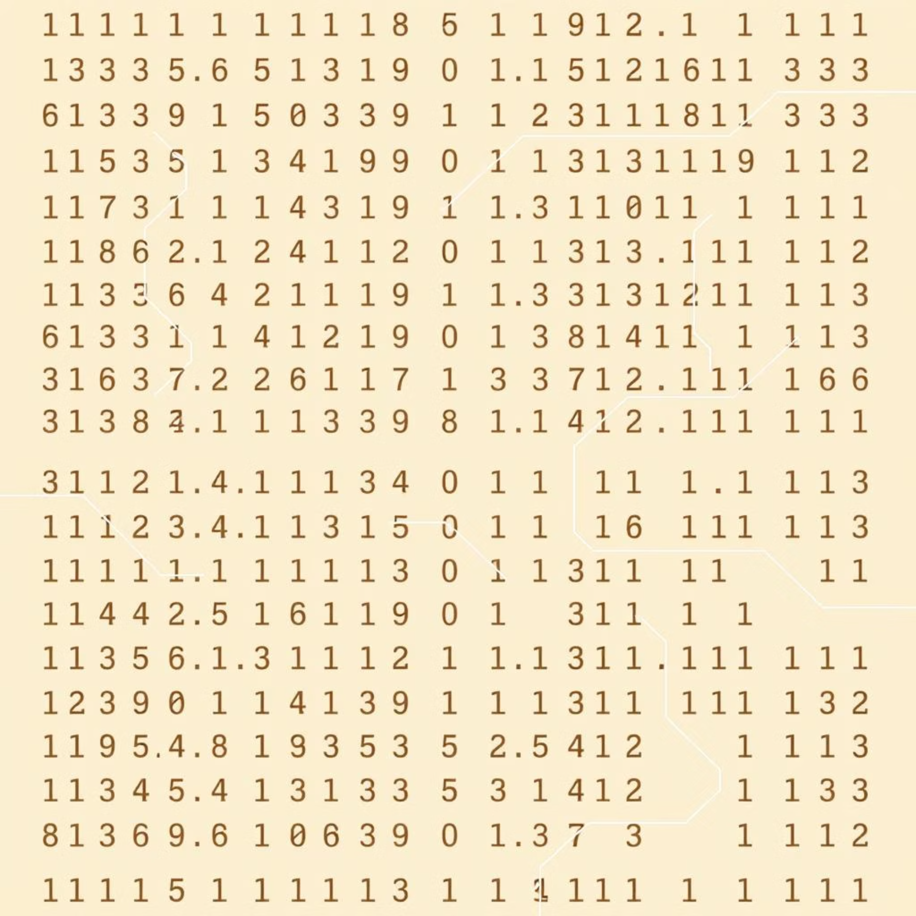
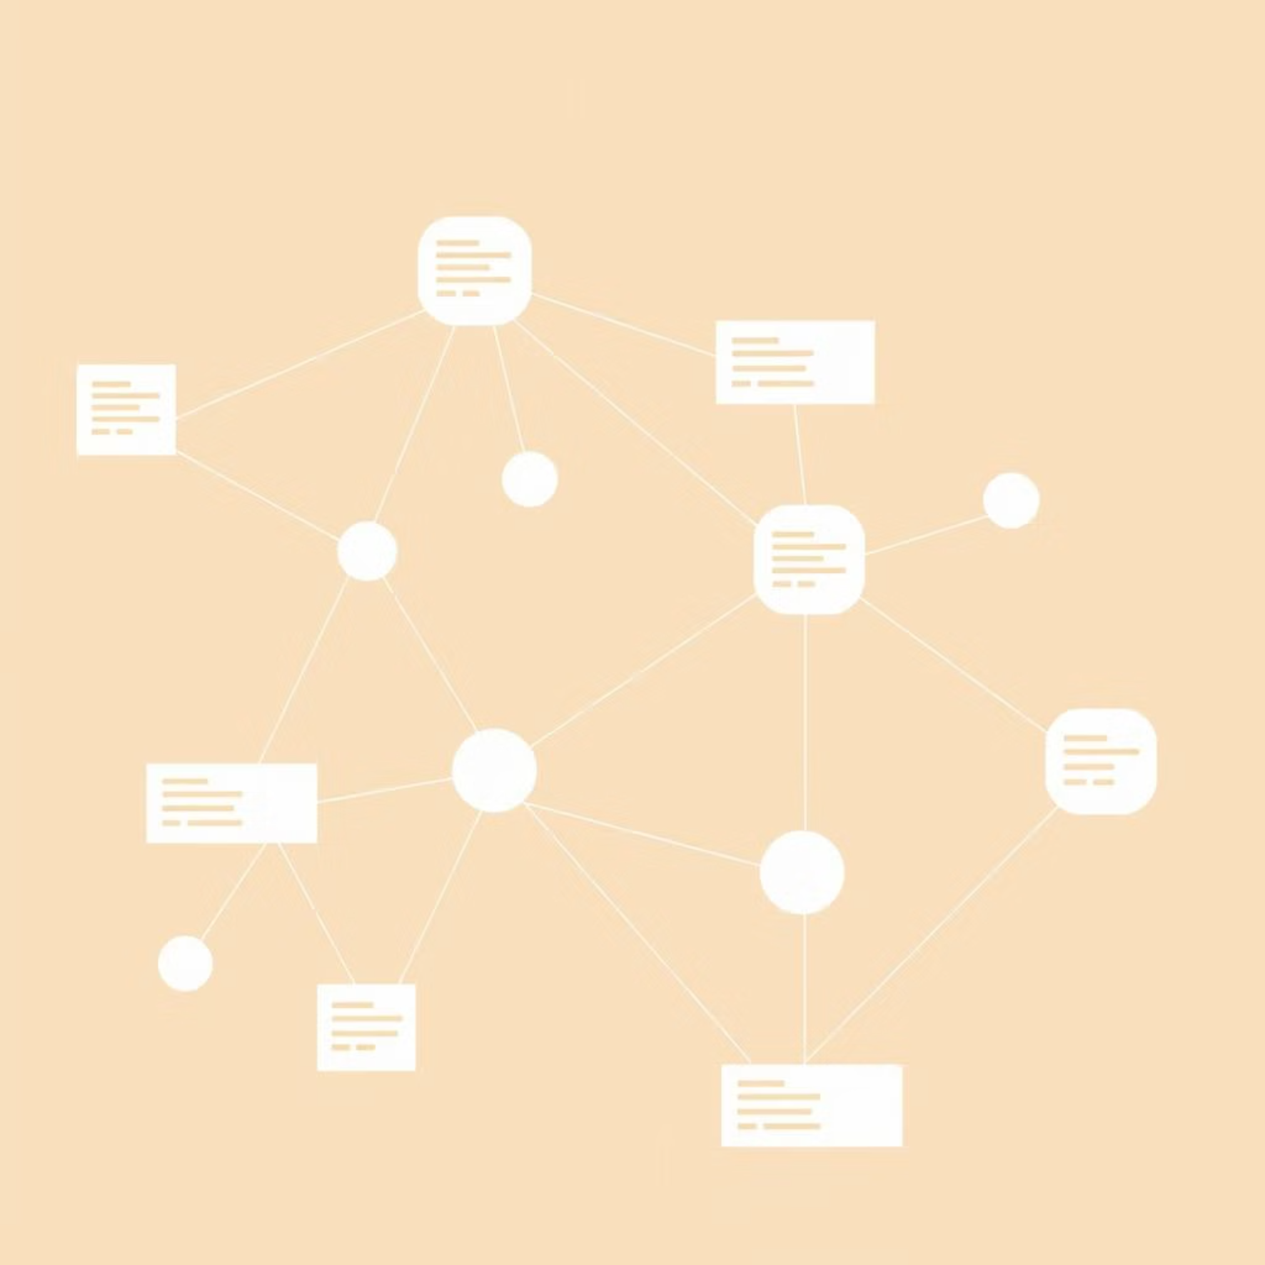
Technologies Used
Programming Language
GUI Framework
Python 3
Tkinter: Built-in, lightweight, and simple for academic projects.
Tokenization
Data Structures
Regular Expressions (Regex): Used for pattern matching and classification.
Lists & Dictionaries: Used for token separation and symbol table construction.

Slide 8

Why These Technologies?
Python
Easy-to-understand syntax, perfect for prototyping compiler logic.
Tkinter
No installation required; ideal for fast GUI development.
Regex
Powerful way to classify tokens efficiently.
Treeview
Provides professional, table-like token representation.

Slide 9
How the System Works
01
02
Enter Code
Analyze
User enters code in the left panel.
“Analyze” button triggers the regex-based lexical analyzer.
03
04
Extract Tokens
Display Tokens
Tokens (Keywords, Identifiers, Operators, Symbols, Numbers) are extracted.
Tokens appear in a right-side table.
05
06
Generate Symbol Table
Clear
Symbol table is generated.
User can clear input/output anytime.

Slide 10



Benefits of the Project
For Students
For Developers
For Academia
Clear understanding of compiler’s first phase.
Can extend to build a Parser.
Perfect demonstration project.
Syntax analyzer.
Simple, portable, and easy to grade.
Visual learning through GUI.
Mini-compiler or Interpreter.
Easy practice for compiler construction.

Slide 11


